Slide 1
OVERALL APPROACH
James K Mandiza

Slide 2

Agenda
Problem Statement
Business Analysis
Recommendation

Slide 3

Introduction
X Education sells online to industry professionals. The company markets its courses on several websites and search engines.
Interested professionals for to the company website and fill up a form providing their details and these customers details are classified as leads. Some leads come through referrals.

Slide 4
Problem Statement
X Education gets a lot of leads but lead conversion rate is poor. The company wishes to make lead conversion process more efficient by identifying most potential leads so that sales team should not waste time on dead leads but lather spend more time communicating with the potential leads.

Slide 5
Problem Solution
We plan to improve the efficiency of the Lead conversion process by building a ML Model which will predict leads that are most likely to convert.
We have used logistic Regression modelling to built this model. And we are able to identify lead features which are contributing most to the probability on a lead getting converted.

Slide 6
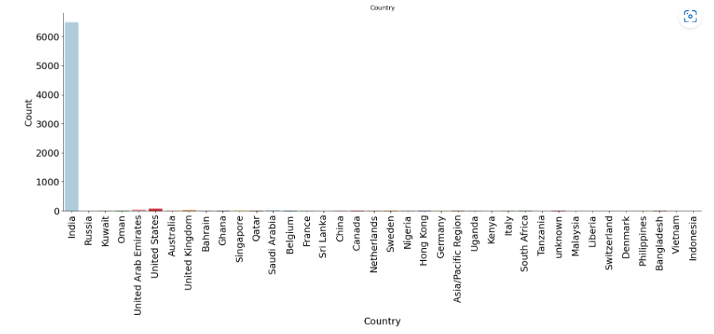
Analysis Results
From the analysis, we have found out that most of the leads are from India.

Slide 7
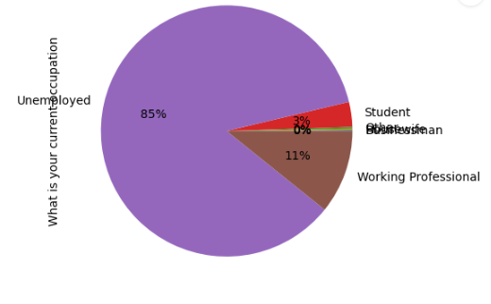
Analysis Results
85% of the leads are unemployed, with 11% Working Professionals

Slide 8
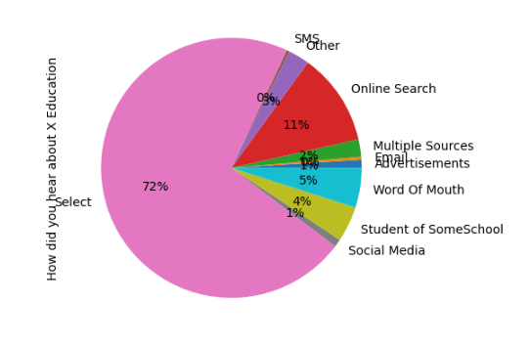
Analysis Results
72% did not specify how they heard about X Education but for those that specified, Online Search is most popular

Slide 9
Analysis Results
72% did not specify how they heard about X Education but for those that specified, Online Search is most popular

Slide 10
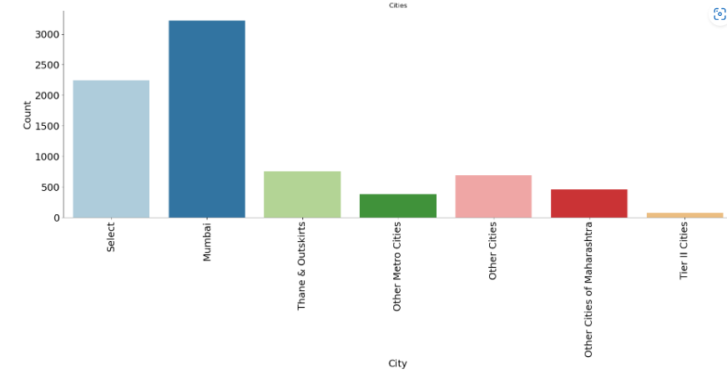
Analysis Results
Most of leads are from Mumbai

Slide 11
Results and Recommendations
The model has identified that the follow lead features contribute most towards probability of getting a lead converted
Tag – Will revert after reading the email
Tag – Closed by Horizzon
Lead whose last activity is SMS Sent
Lead which spend more time on website
2. Lead source from Google and lead profile of Student from same school are reducing the probability of getting a lead converted.

Slide 12
Recommendations
We recommended we use this model to identify all leads that are most likely to convert so that sales team can spend more time communicating with these leads.
This will reduce time spend on trying to communicate to leads that will not convert, and the end result will be a much-improved conversion rate

Slide 13




Thank you

